Slide 1

CAPSTONE PROJECT Sign language detection using deep learning
Presented By
Student Name: AKASH KUMAR PASWAN
College Name: ITM COLLEGE OF MANAGEMENT
Department: BCA (Bachelor of Computer Application)
Email ID: paswanakashkumar1@gmail.com
AICTE Student ID: STU67664589de0881734755721

Slide 2
OUTLINE
Problem Statement (Should not include solution)
Proposed System/Solution
System Development Approach (Technology Used)
Algorithm & Deployment
Result (Output Image)
Conclusion
Future Scope
References

Slide 3
Problem Statement
Sign language is a crucial mode of communication for the deaf and hard-of-hearing community. However, there is a significant barrier in communication between sign language users and those who do not understand it. Traditional methods of interpreting sign language are often limited by the availability of skilled interpreters and can be time-consuming. This creates a need for an automated system that can accurately detect and interpret sign language gestures in real-time, facilitating better communication and inclusivity.

Slide 4
Proposed Solution
We propose the development of a sign language detection system using deep learning techniques. This system will utilize computer vision and machine learning algorithms to recognize and interpret sign language gestures from video input, providing real-time translation into text or speech. The goal is to create an accessible tool that bridges the communication gap between sign language users and non-users.

Slide 5
System Approach
The system will be developed using the following technologies:
Programming Languages: Python for implementing machine learning models and data processing.
Deep Learning Frameworks: TensorFlow and Kera's for building and training neural networks.
Computer Vision Libraries: OpenCV for image processing and video analysis.
Data Annotation Tools: Labeling or similar tools for annotating sign language gesture datasets.
User Interface: Flask or Django for creating a web-based application to interact with the system.

Slide 6
Algorithm & Deployment
The core of the system will employ convolutional neural networks (CNNs) for gesture recognition. The deployment process will involve:
Data Collection: Gathering a diverse dataset of sign language gestures.
Model Training: Training the CNN on the annotated dataset to recognize various signs.
Real-time Processing: Implementing the model in a web application that captures video input and processes it in real-time.
Deployment: Hosting the application on cloud platforms like AWS or Azure for scalability and accessibility.

Slide 7
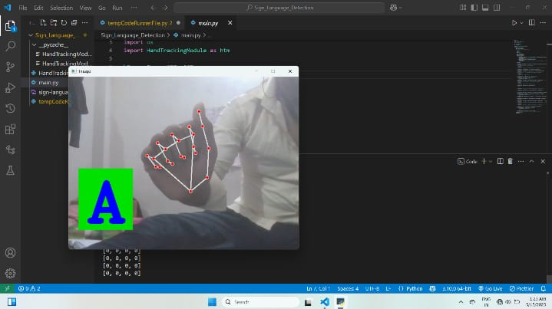
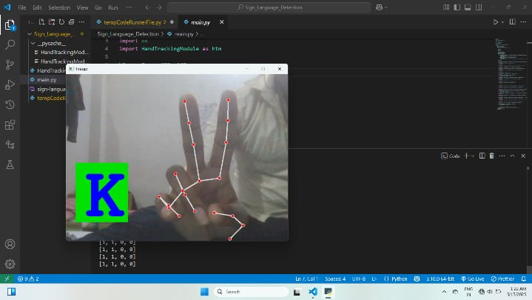
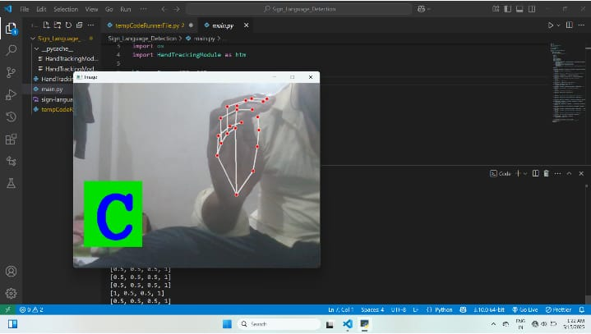
Result
Present the results of the machine learning model in terms of its accuracy and effectiveness in predicting bike counts. Include visualizations and comparisons between predicted and actual counts to highlight the model's performance.

Slide 8
Conclusion
The proposed sign language detection system aims to enhance communication between sign language users and non-users by providing an automated, real-time interpretation of gestures. By leveraging deep learning and computer vision technologies, the system has the potential to significantly improve accessibility and inclusivity for the deaf and hard-of-hearing community.

Slide 9
Future scope
Future developments may include:
Expanding the system to support multiple sign languages.
Enhancing the model's accuracy with more diverse datasets and advanced algorithms.
Integrating voice synthesis for spoken output of detected signs.
Developing mobile applications to increase accessibility and usability.

Slide 10
References
"Deep Learning for Computer Vision with Python" by Adrian Rosebrock.
"Hands-On Machine Learning with Scikit-Learn, Keras, and TensorFlow" by Aurélien Geron.
"Sign Language Recognition: A Review" in the Journal of Computer Vision and Image Understanding.
GitHub Link: https://github.com/akashpaswan09/Sign-language-detection-using-deep-learning-

Slide 11
Thank you

